Slide 1
The Hunger Games at Colorado State University
Bringing the Book to Life

Slide 2
A Fall Semester Kick-Off Event
NCTE@CSU wanted to create an event for the beginning of the year that:
was fun, interactive, and creative.
would allow for anyone from the community to participate.
that could be duplicated in the classroom.

Slide 3
Why The Hunger Games by Suzanne Collins
Several of the officers had read the book and were hooked.
An Adolescents’ Literature class of approximately 40 college students agreed that it was a good book.

Slide 4
The Idea
Recreate the fighting stage of the Arena on the CSU campus.
Create a cornucopia in one location and take participants to strategic locations of campus.
Supply participants with safe and fun methods of eliminating each other.
Provide enough information for participants to end their journey in one location.
Create activities for quickly eliminated participants.

Slide 5
In Preparation for the Event
Marketing:
Display Case
Fliers and School/Newspaper Calendar
Event checklist
Individual responsibilities
Rules of Engagement, Extra Life Awards, Maps
Booths for Participants Quickly Eliminated
Toastmasters Club
Knot Tying
Camouflage
Cookie Decorating

Slide 6
A Glimpse of the Event
Video of Hunger Games at CSU

Slide 7
Activity Related to New Standards
According to the New Colorado Academic Standards for “Reading, Writing, and Communicating,” prepared graduates:
Collaborate effectively as group members or leaders who listen actively and respectfully pose thoughtful questions, acknowledge the ideas of others, and contribute ideas to further the group’s attainment of an objective
Deliver organized and effective oral presentations for diverse audiences and varied purposes
Use language appropriate for purpose and audience
Demonstrate skill in inferential and evaluative listening

Slide 8
The Hunger Games Interview
Divide students into pairs like tributes from the Districts of Panem.
Ask them to prepare for a public interview and analyze the expectations of the audience.
Participate in an “on-stage” interview.
Ask reflective questions of other potential competitors.
Reflect on the experience.

Slide 9
Addressing the New Standards
Asks students to be aware of audience expectations.
Requires students to be reflective listeners.
Allows students to role-play a character, which can be less intimidating than public speaking.
Provides opportunity for collaboration.

Slide 10
The Hunger Games Across Content Areas
Technology
Video Production
Social Networking
The Arts
Cooking
Costume and Set Design
Drawing
Music
Theater and Role Play
Creative Writing/Fan Fiction

Slide 11
The Hunger Games Across Content Areas
Math
– Calculating Tesserae
Science/Outdoor Education
First Aid
Genetics
Natural Foods
Camouflage

Slide 12
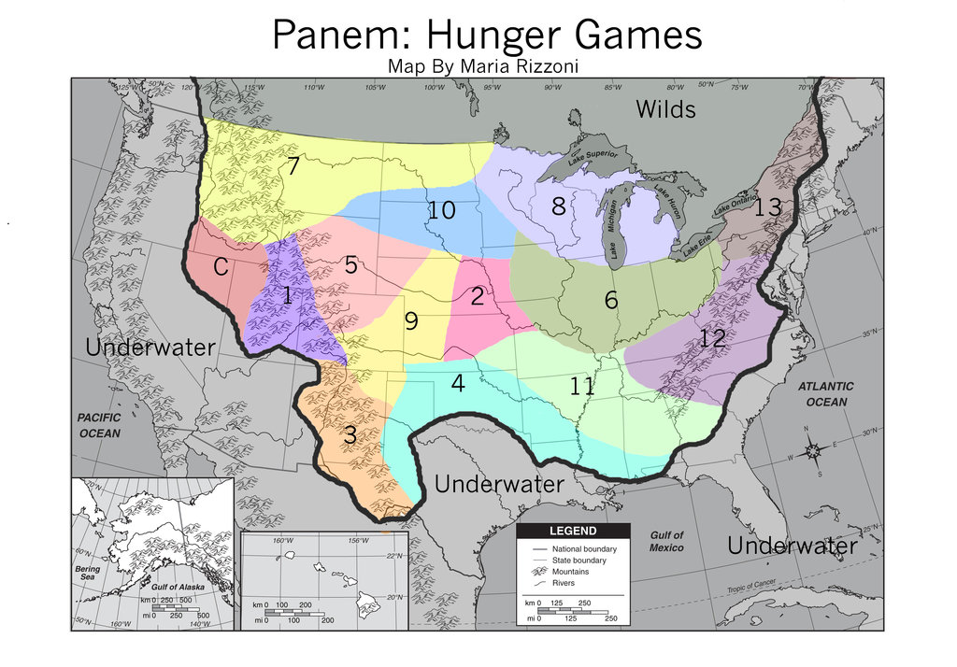
The Hunger Games Across Content Areas
Social Studies
Geography

Slide 13
The Hunger Games Across Content Areas
Social Studies
Distribution of Goods and Services
Dystopian Governments
Speech
Public Relations
Media Studies
Physical Education
Archery
Rock Climbing

Slide 14
Classroom Discussion
An activity of this caliber and excitement will provide a great opportunity for classroom discussion.
The classroom discussion could be done in
Partners (think, pair, share)
Small groups
Whole class
Socratic seminar
Fishbowl

Slide 15
Sample Discussion Questions
1. Why does the government of Panem use such drastic measures to scare the districts into obedience?
2. How does the government control and the hunger games resemble things you have witnessed on TV or learned about in world history?

Slide 16
A Multiliteracies Project
Using video or podcasts, individual students or small groups could
Create a utopian society of their own.
Create a map, constitution, laws, and even a national anthem.
Develop a music video for the text.
Design a blog site dedicated to discussing the book.

